Slide 1
Modeling Unbalanced Classes

Slide 2
Learning Goals
In this section, we will cover:
- Issues that arise when class outcomes are unbalanced
- Approaches to dealing with unbalanced data
- Upsample, Downsample, and Resample approaches to unbalanced class data

Slide 3
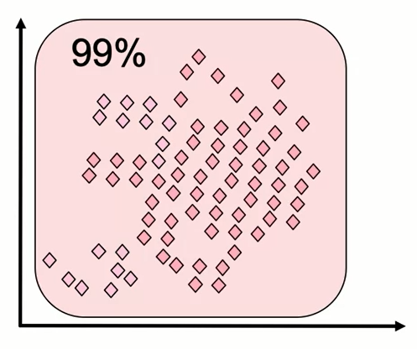
Unbalanced Classes
Classifiers are usually built to optimize accuracy and hence will often perform poorly on unbalanced classes.

Slide 4
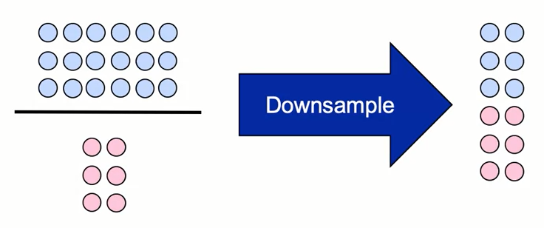
Unbalanced Classes
For unbalanced datasets, we can balance the size of the classes by either downsampling the larger class or upsampling the small one.

Slide 5
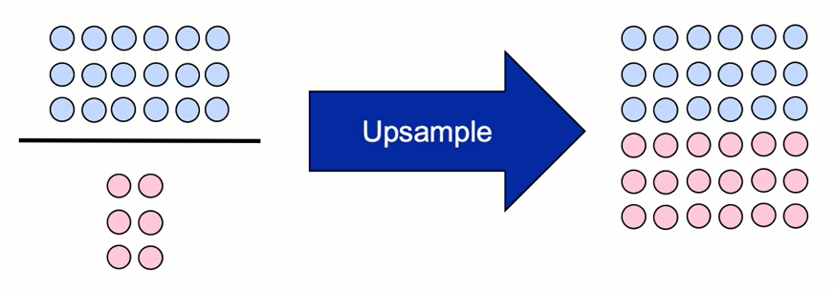
Unbalanced Classes
For unbalanced datasets, we can balance the size of the classes by either downsampling the larger class or upsampling the small one.

Slide 6
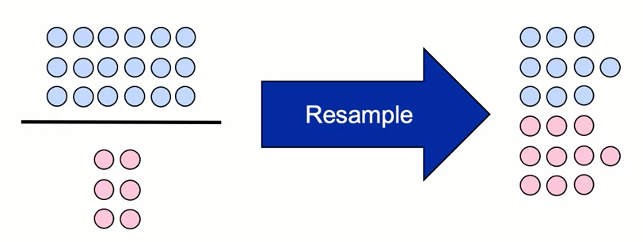
Unbalanced Classes
We can also do a mix of the two. In this example 6 < s < 19 for sampling. If we choose s = 10:

Slide 7
Unbalanced Classes
Steps for unbalanced datasets:
- Do a stratified test-train split
- Up or down sample the full dataset
- Build models

Slide 8
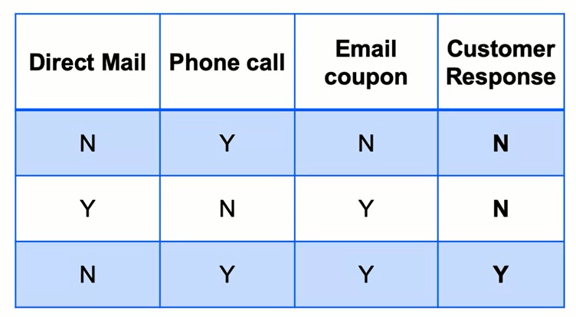
Unbalanced Classes
With unbalanced classes, the data often isn't easily separable. We must choose to make sacrifices to one class or the other.
Consider the following data about an email campaign:

Slide 9
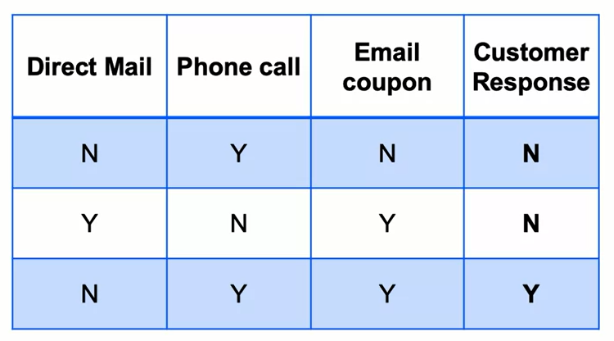
Unbalanced Classes
For every minor-class data-point identified as such, we might wrongly label a few major-class points as minor-class.
So as recall goes up, precision will likely go down.

Slide 10
Unbalanced Classes
Downsampling adds tremendous importance to the minor class, typically shooting up recall and bringing down precision.
Values like 0.8 recall and 0.15 precision isn't uncommon.

Slide 11
Unbalanced Classes
Upsampling mitigates some of the excessive weight on the minor class. Recall is still typically higher than precision, but the gap is lesser.
Values like 0.7 recall and 0.4 precision isn't uncommon. And are often considered good results for an unbalanced dataset.

Slide 12
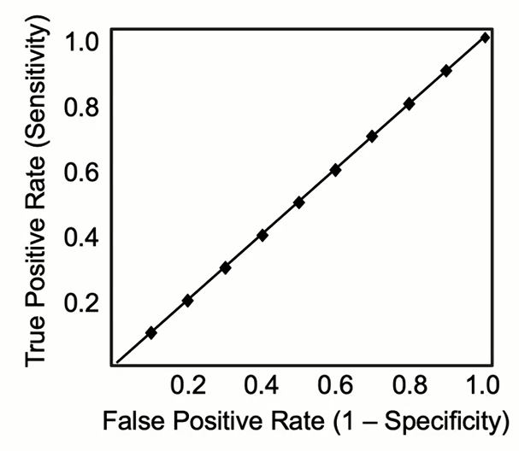
Unbalanced Classes
Cross-validation works for any global model-making choice, including sampling.

Slide 13
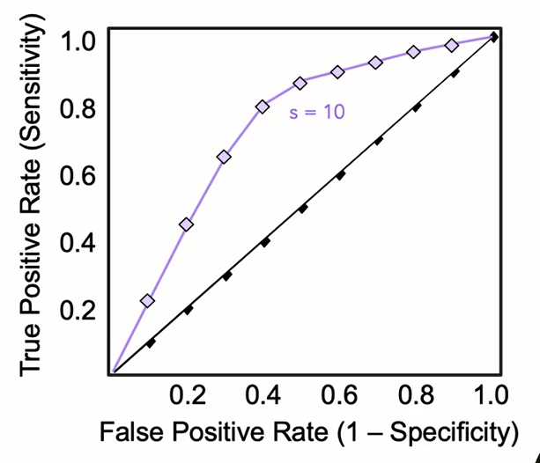
Unbalanced Classes
Cross-validation works for any global model-making choice, including sampling.

Slide 14
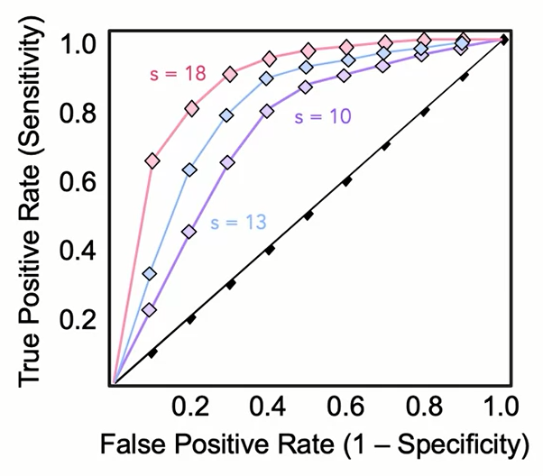
Unbalanced Classes
Cross-validation works for any global model-making choice, including sampling.

Slide 15
Unbalanced Classes
Every classifier used produces a different model.
Every dataset we use (produced by various sampling, say) produces a different model.
We can choose the best model using any criteria including AUC (area under the curve). Remember each model produces a different ROC curve.
Once a model is chosen. You can walk along the ROC curve and pick any point on it. Each point has different precision/recall values.

Slide 16
Learning Recap
In this section, we discussed:
- Issues that arise when class outcomes are unbalanced
- Approaches to dealing with unbalanced data
- Upsample, Downsample, and Resample approaches to unbalanced class data

Slide 17
Learning Goals
In this section, we will cover:
- Additional approaches to dealing with unbalanced outcomes
- Random and Synthetic Over Sampling
- Techniques for Under Sampling
- Using Balanced Bagging (Blagging) to address unbalanced class data

Slide 18
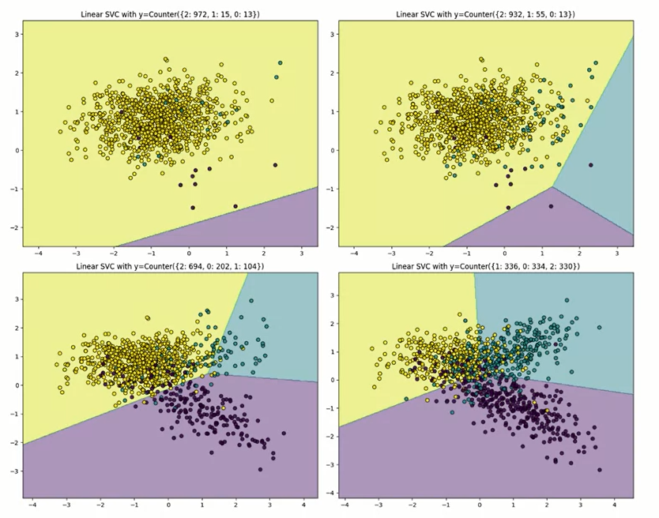
The Problem

Slide 19
Lots of Approaches
- General sklearn approaches
- Oversampling
- Undersampling
- Combination
- Ensembles
- Check out http://contrib.scikit-learn.org/imbalanced-learn

Slide 20
Weighting
Many models allow weighted observations
- Adjust these so total weights are equal across classes
- Easy to do, when it's available
- No need to sacrifice data

Slide 21
Stratified Sampling
- Train-test split, “stratify" option
- Shuffle Split -> Stratified Shuffle Split
- KFold -> StratifiedKFold -> RepeatedStratifiedKFold

Slide 22
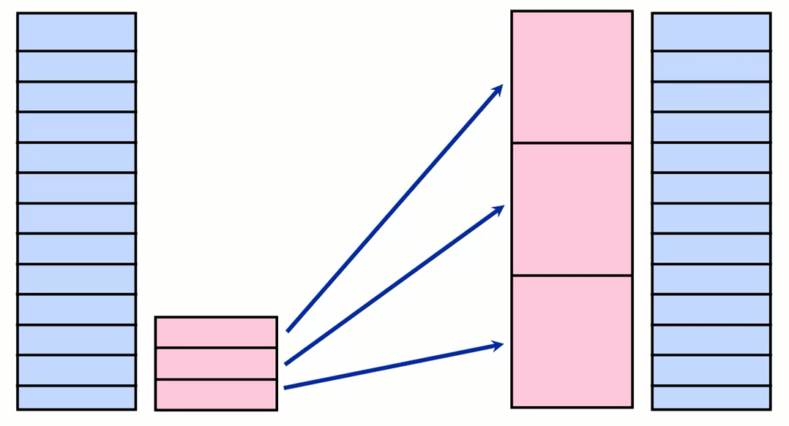
Oversampling

Slide 23
Random Oversampling
- Simplest oversampling approach
- Resample with replacement from minority class
- No concerns about geometry of feature space
- Good for categorical data

Slide 24
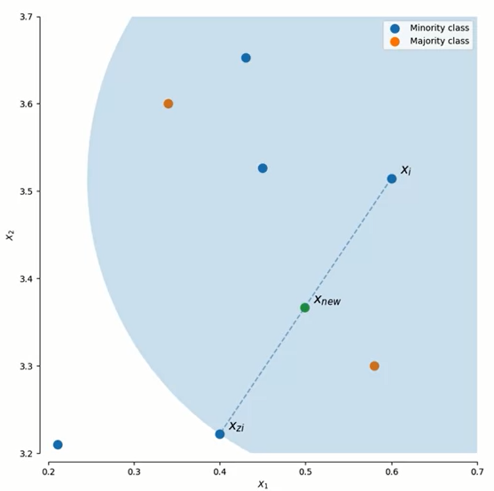
Synthetic Oversampling
- Start with a point in the minority class
- Choose one of K nearest neighbors
- Add a new point between them
- Two main approaches:
• SMOTE
• ADASYN
http://contrib.scikit-learn.org/imbalanced-learn/stable/over_sampling.html#a-practical-guide

Slide 25
SMOTE:
Synthetic Minority Oversampling Technique
- Regular: Connect minority class points to any neighbor (even other classes)
- Borderline: Classify points as outlier, safe, or in-danger
• 1: Connect minority in-danger points only to minority points
• 2: Connect minority in-danger points to whatever is nearby
- SVM: Use minority support vectors to generate new points

Slide 26
ADASYN: ADAptive SYNthetic sampling
- For each minority point:
• Look at classes in neighborhood
• Generate new samples proportional to competing classes
- Motivated by KNN, but helps other classifiers as well

Slide 27
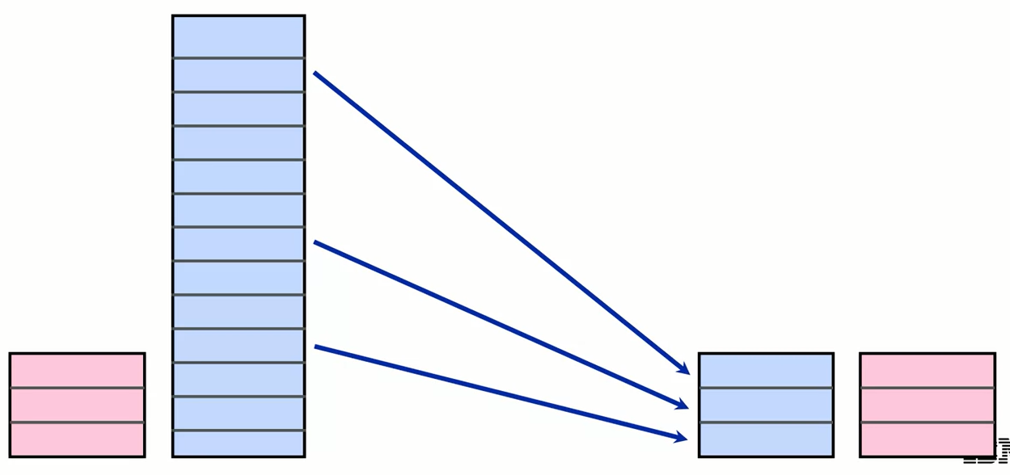
Undersampling

Slide 28
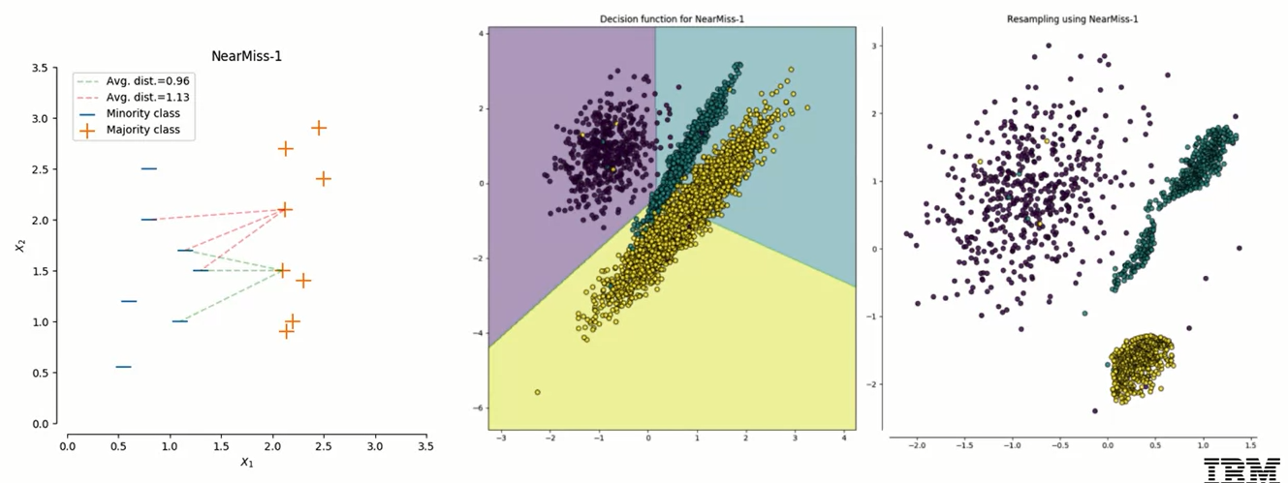
Near Miss-1: Which Points to Keep? Those Closest to Nearby Minority Points

Slide 29
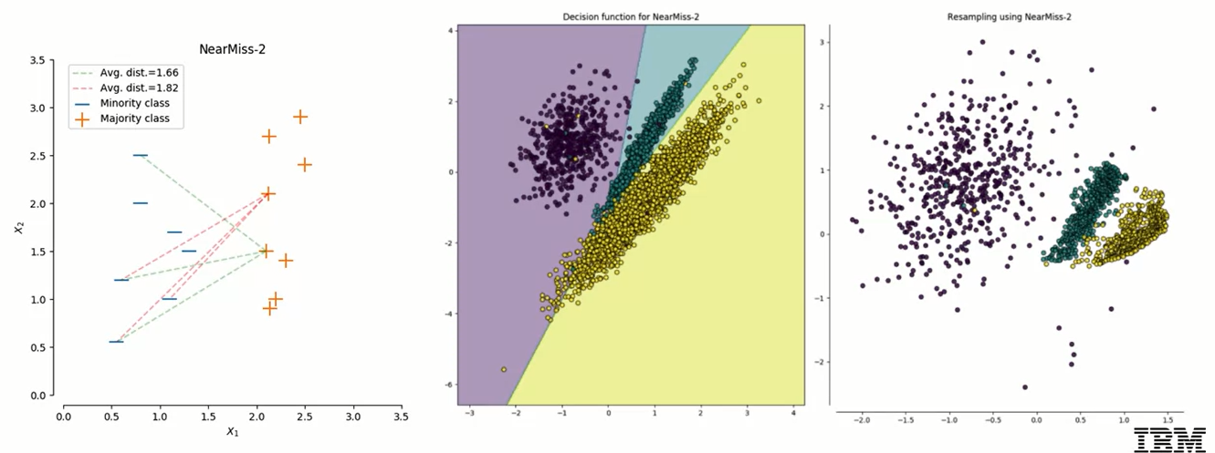
Near Miss-2: Which Points to Keep? Those Closest to Distant Minority Points

Slide 30
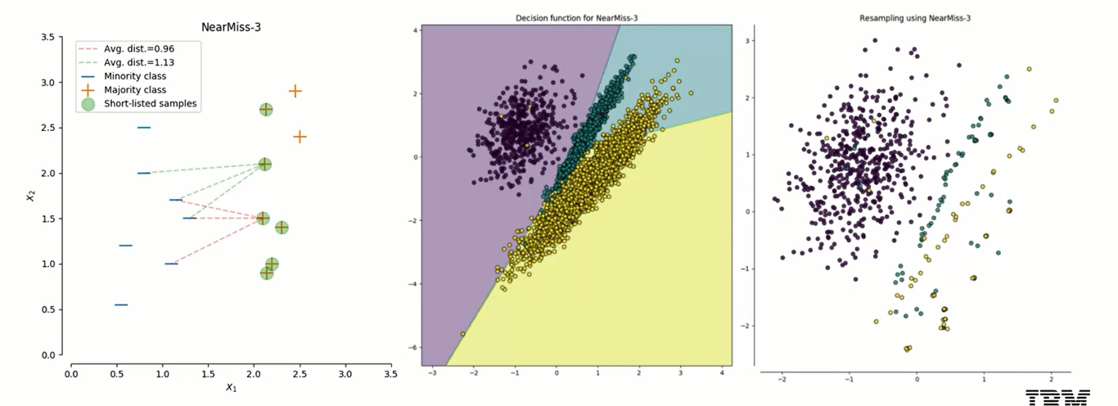
Near Miss-3: Those Closest to Majority Neighbors of Minority Points

Slide 31
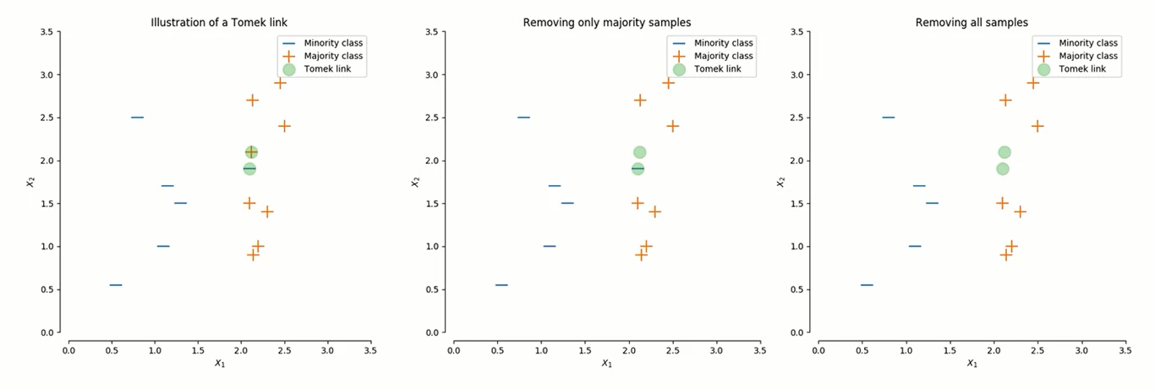
Tomek Links: Mixed Mutual Nearest Neighbors

Slide 32
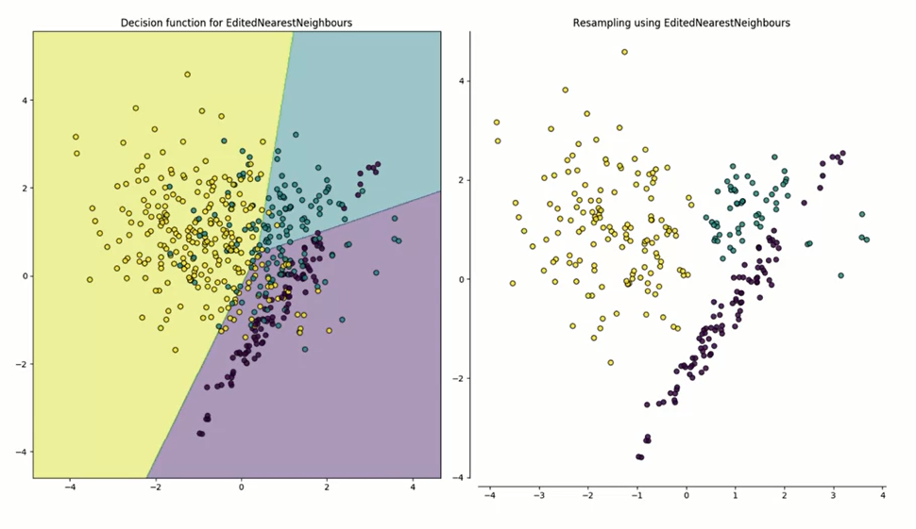
Edited Nearest Neighbors
- Remove points that don't agree with neighbors

Slide 33
Combination Over/Under
- SMOTE + Tomek's link
- SMOTE + Edited Nearest Neighbors

Slide 34
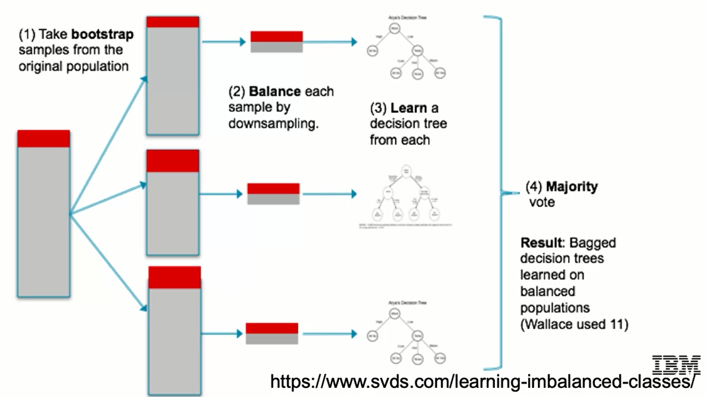
Blagging (Balanced Bagging)

Slide 35
Unbalanced Classes: Summary
- All of this happens after the test set has been split.
- Use sensible metrics
• AUC
• F1
• Cohen's Kappa
• Not accuracy - too easy to fool in this case

Slide 36
Summary
Modeling Approaches for Unbalanced Classes
Specific algorithms to upsample and downsample are:
Stratified sampling
Random oversampling
Synthetic oversampling, the main two approaches being Synthetic Minority Oversampling Technique (SMOTE) and Adaptive Synthetic sampling (ADASYN)
Cluster Centroids implementations like NearMiss, Tomek Links, and Nearest Neighbors

Slide 37
Learning Recap
In this section, we discussed:
- Additional approaches to dealing with unbalanced outcomes
- Random and Synthetic Over Sampling
- Techniques for Under Sampling
- Using Balanced Bagging (Blagging) to address unbalanced class data

